Slide 1

Recurrent Neural Network Models for Human Activity Recognition
Request to view the ppt in presentation mode
IE7860: Intelligent Analytics
Final Term Project
20th April 2020
Team:
Mathai Paul *
Theju Gowda *

Slide 2
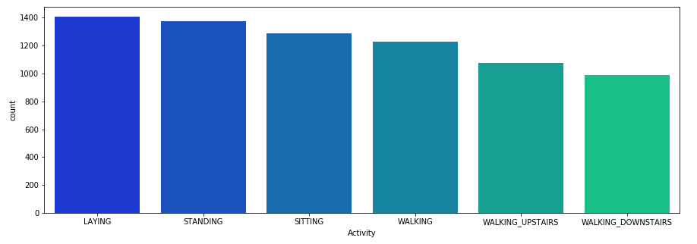
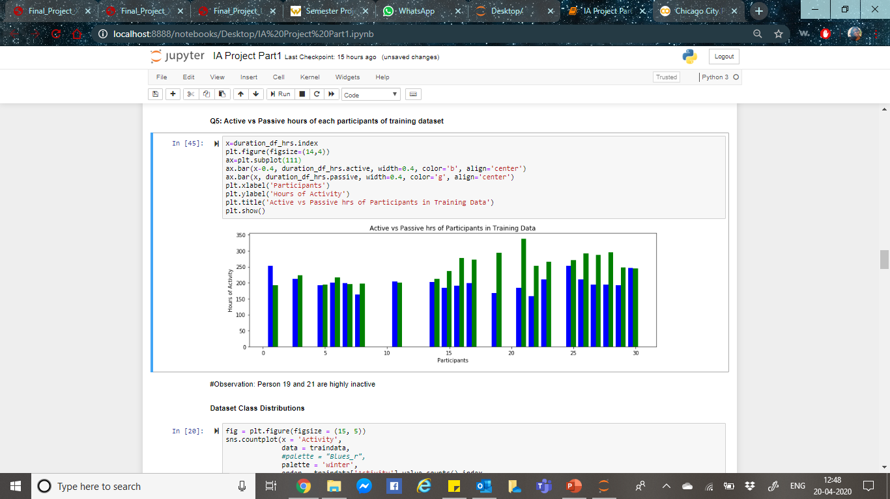
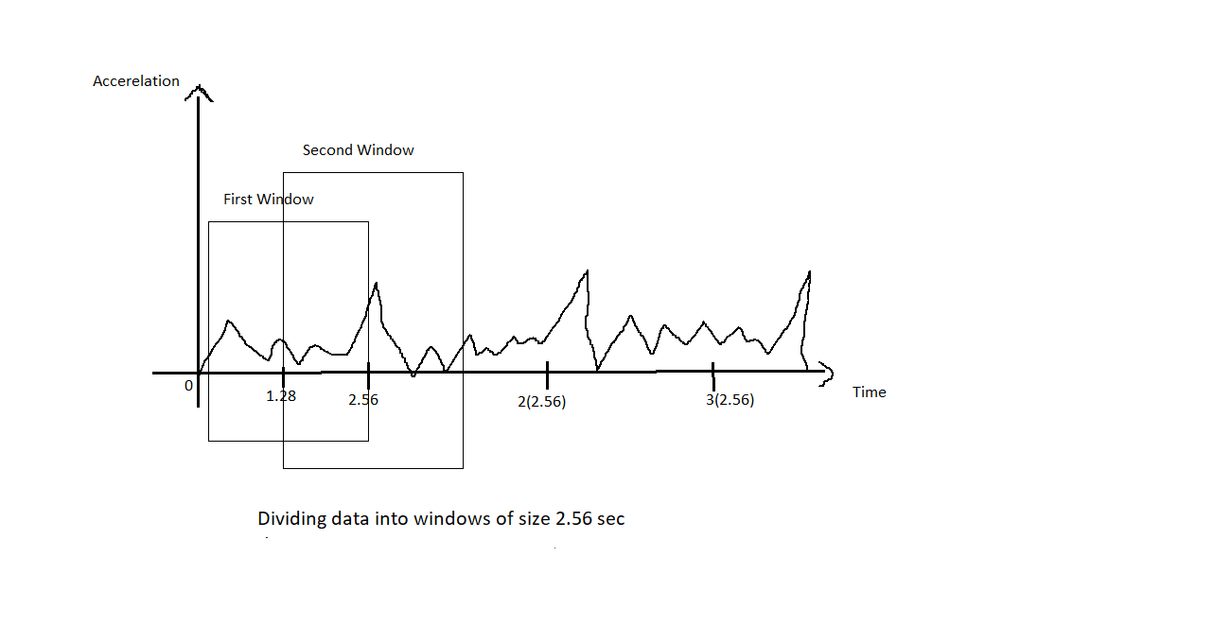
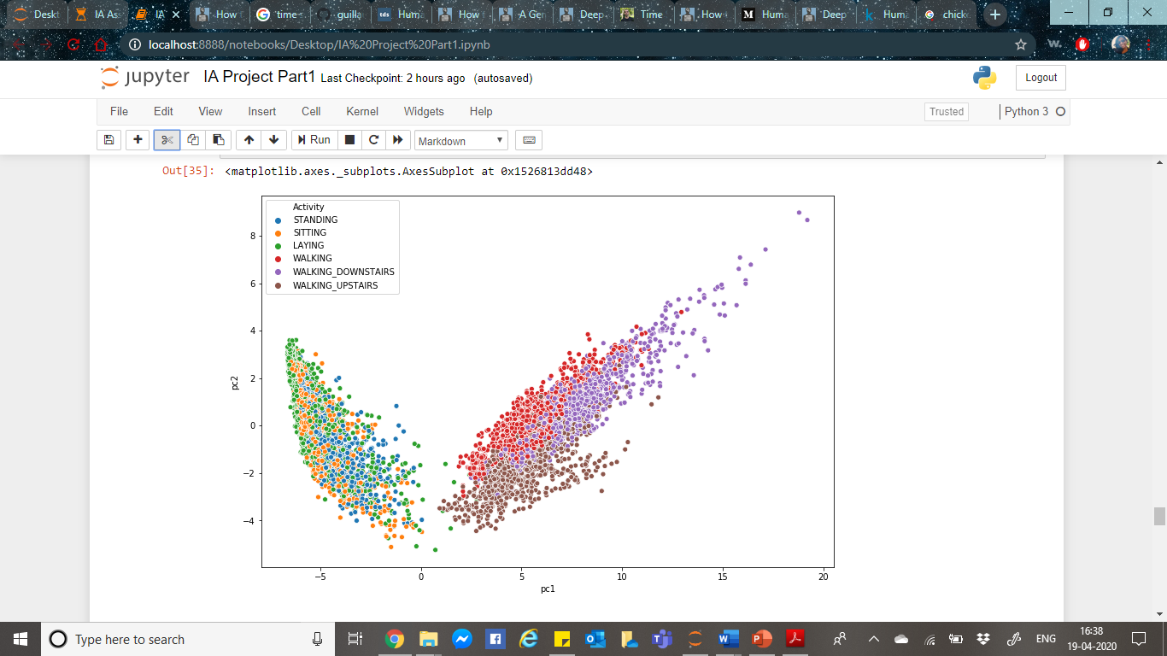
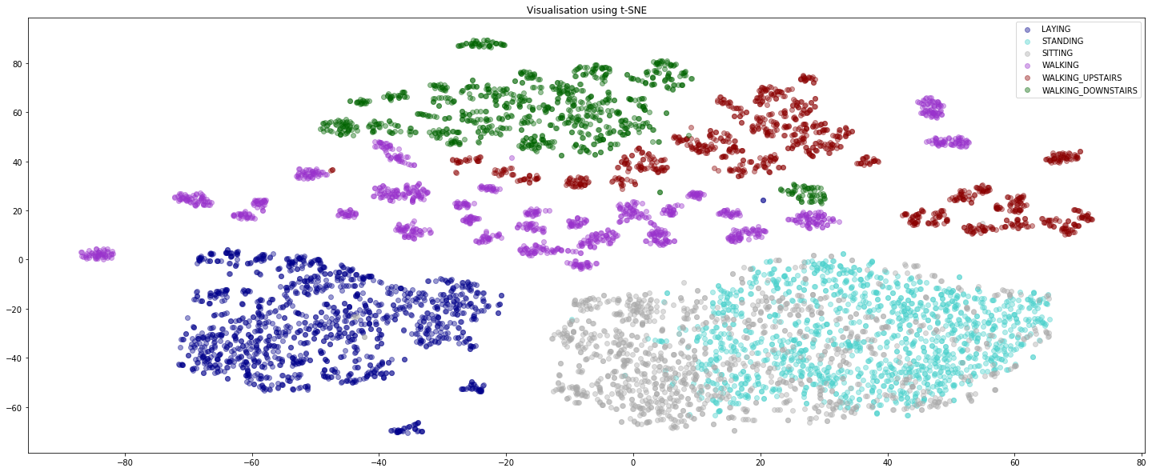
DATASET/PROBLEM DEFINATION:

Slide 3
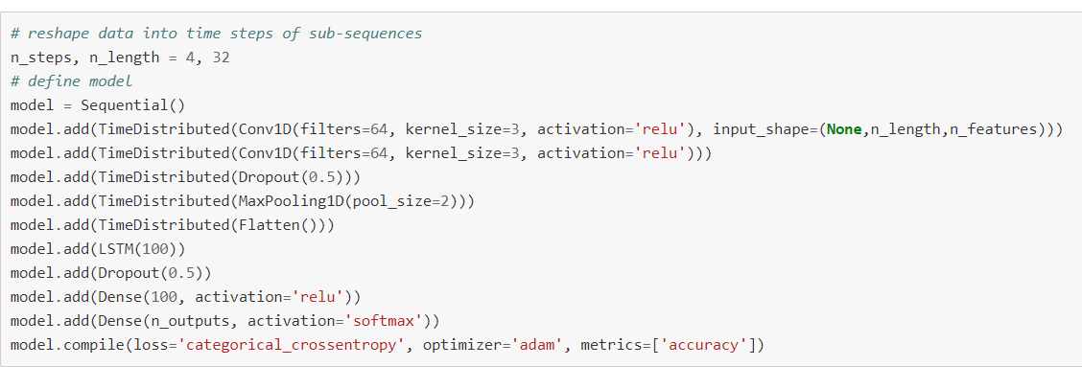
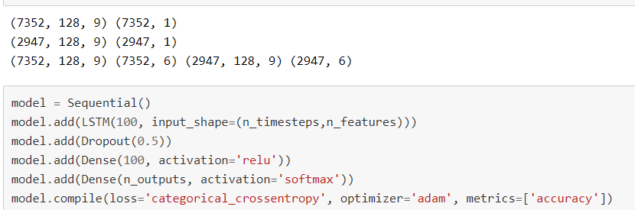
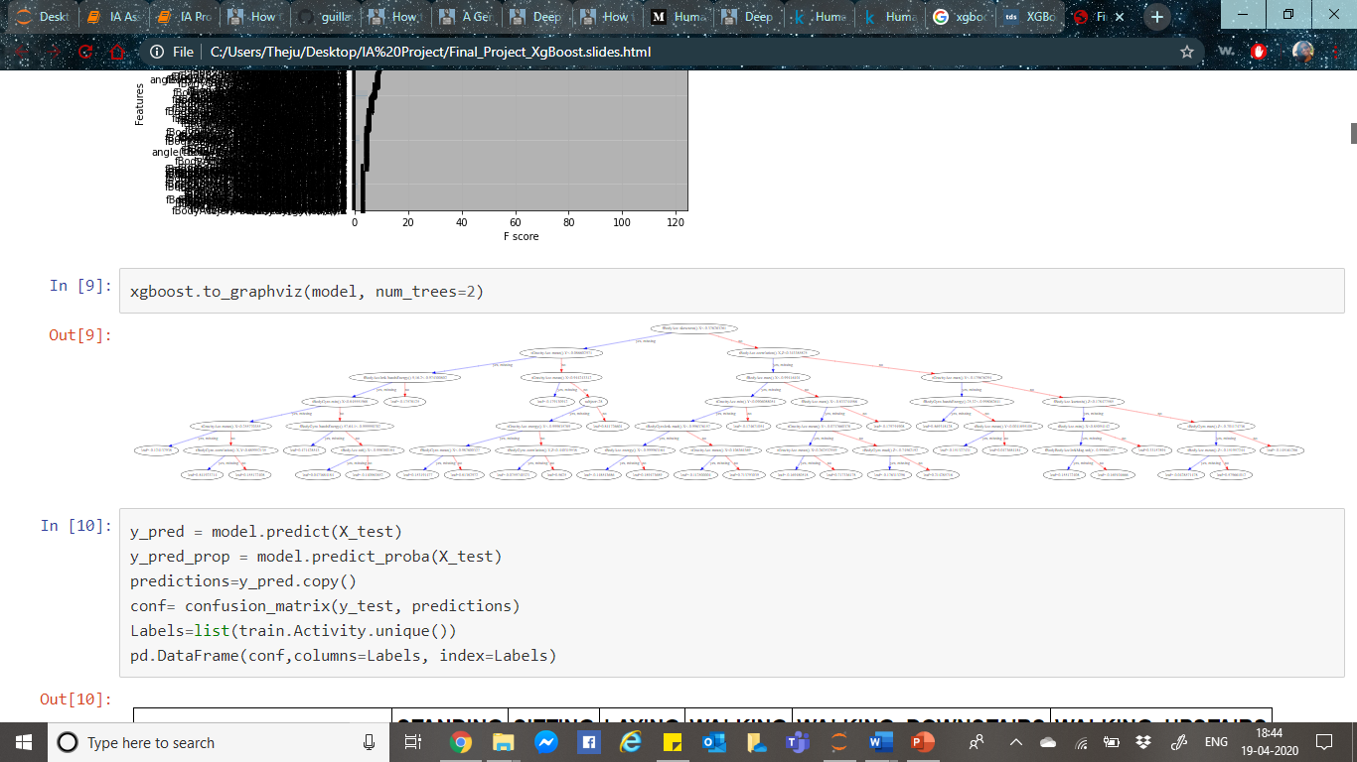
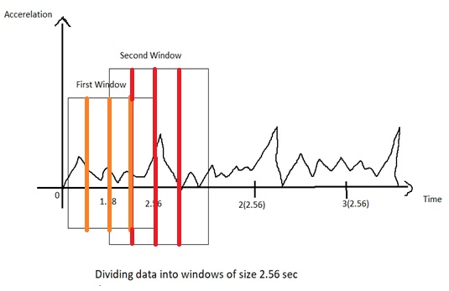
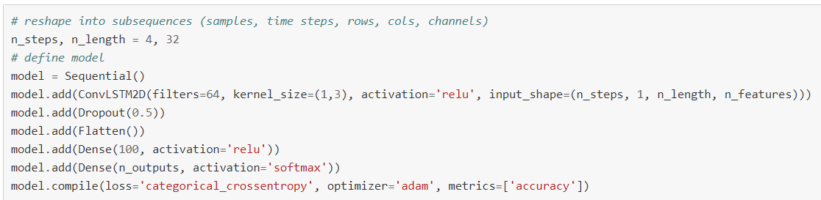
METHODOLOGY:
XGBOOST:
LSTM:
CNN_LSTM:
ConvLSTM:

Slide 4
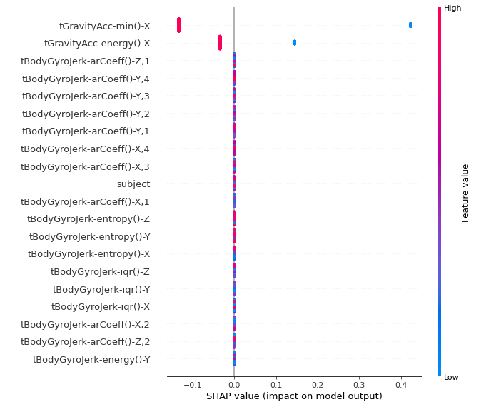
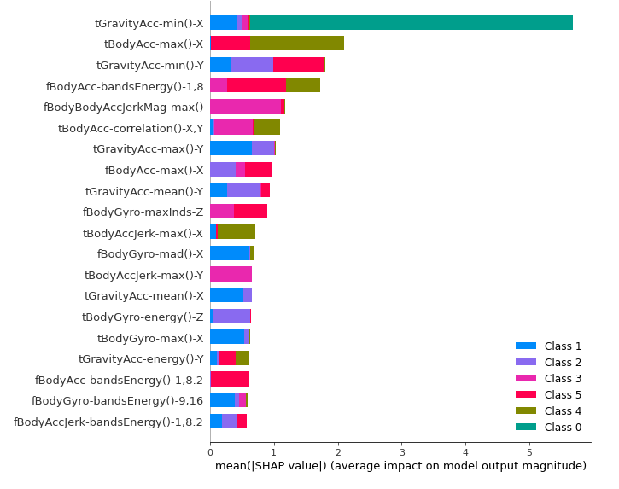
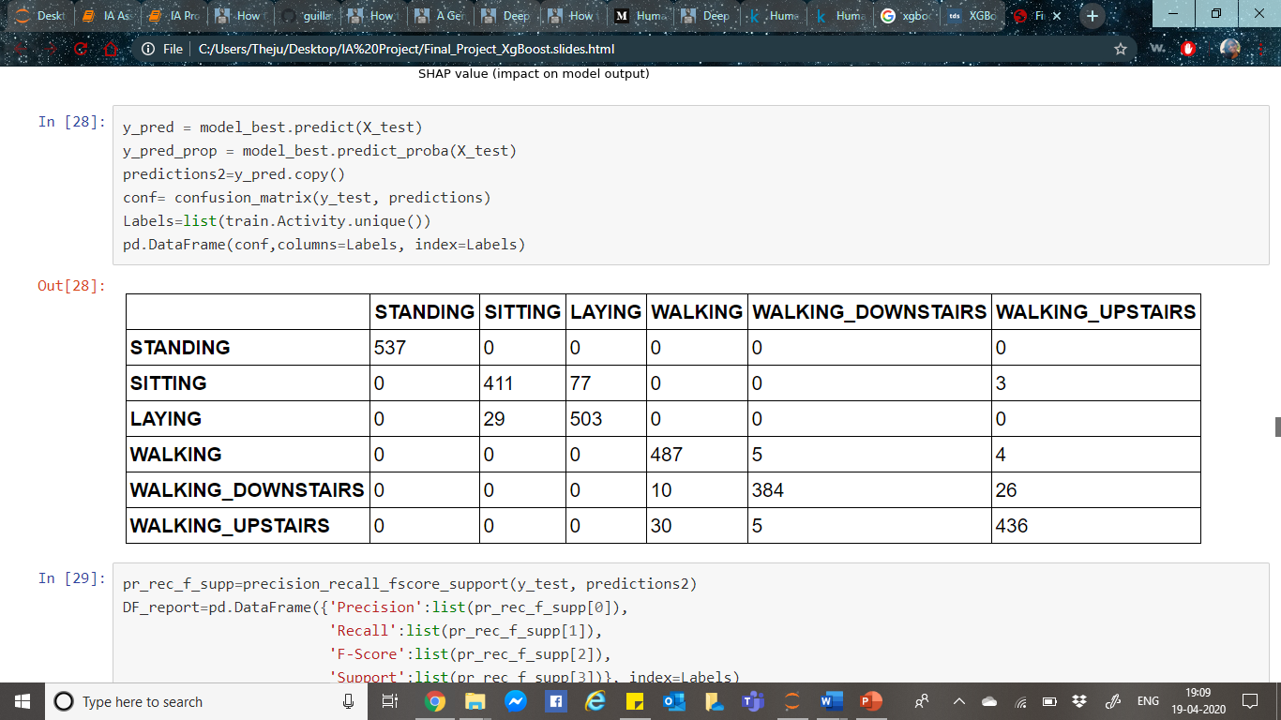
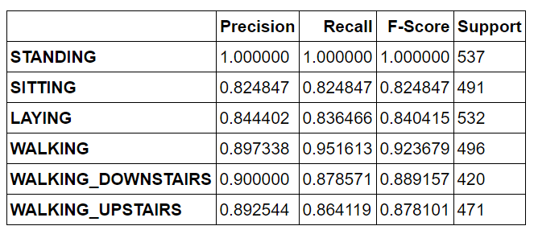
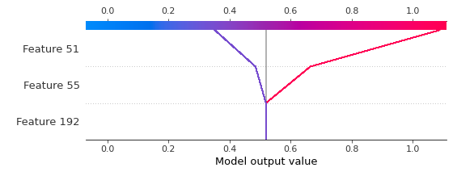
RESULT/LEARNING:
XGBOOST:
Hyperparameter Tuning
SHAP
Result:
LSTM:
Fit & Evaluate Model
Run Exp: 10 Repeats
Hyperparameter Tuning
Result:
90.261
92.161
92.229
92.161
91.890
91.822
91.720
92.500
91.381
90.532
Accuracy: 91.666%
Hyperparameter Tuning:
(22 iterations, 15 epochs)
Validation Accuracy: 95.65%
CNN_LSTM:
Subsequence
Time Distributed Layer
Flattened
LSTM
Result:
91.788
91.788
91.856
90.397
91.923
92.806
93.315
92.365
93.315
92.229
Accuracy: 92.178%
ConvLSTM:
ConvoLSTM2D
Subsequence
Flattened
LSTM
Result:
91.618
90.091
90.532
91.618
91.347
91.991
92.534
91.957
91.347
91.788
Accuracy: 91.483
Notes:
XGBoost: After hyperparameter tuning, we get perfect classification for Standing and Sitting with precession of 1 for Standing. With SHAP, we can see the features importance and class distribution.
LSTM: After 10 repeats the avg accuracy is 91.6% . We tried hyperparameter tuning, it ran just 2% wit 15 epochs, the highest validation accuracy we got among these 22 iterations was 95.65%.
CNN_LSTM: We got Avg. accuracy of 92%
ConoLSTM: We got Avg. Accuracy of 91%
With our study and with the computational limitations we had LSTM shows better results. But when hyperparameter tuning is applied to all the models uniformly and checked for model performance, CNN_LSTM would eventually be a better model as with dimensionality reduction, it becomes a fast performing model with better accuracy.

